Slide 1
Alternate Dynamics Model For Bayesian Filtering
RBE500-F17-191
Lecture 07-1
Adj. Prof. Julian Center

Slide 2
Bayes Filter Reminder
Prediction
Correction
Posterior
Prior

Slide 3
Discrete-Time Kalman Filter
Estimates the state x of a discrete-time controlled process that is governed by the linear stochastic difference equation
Thrun, et. Al.
$$x_{t}=A_{t−Δt}x_{t−Δt}+B_{t−Δt}u_{t−Δt}+D_{t−∆t}ψ_{t−Δt}+ε_{t−Δt}$$
with the (same)
measurement model.
Control Noise
Thrun, et. Al.

Slide 4

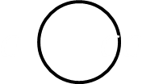
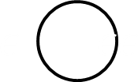









Bayesian Graph for Thrun’s Kalman Filter Model
$$ε{}_{}εε$$
$$ε{}_{}εε$$
$$ε{}_{}εε$$
$$ε_{t−1}$$
$${ ε}_{t}$$
$$ε_{t+1}$$
$$ε{}_{}εε$$
$$ε{}_{}εε$$
$$ε{}_{}εε$$
$$δ_{t−1}$$
$$δ_{t}$$
$$δ_{t+1}$$

Slide 5
















Bayesian Graph for Kalman Filter Model with Alternate Dynamics Model
$$ε{}_{}εε$$
$$ε{}_{}εε$$
$$ε{}_{}εε$$
$$ψ_{t−2}$$
$$ψ_{t−1}$$
$$ψ_{t}$$
$$ε{}_{}εε$$
$$ε{}_{}εε$$
$$ε{}_{}εε$$
$$ε_{t−2∆t}$$
$${ ε}_{t−∆t}$$
$$ε_{t}$$
$$u_{t−2∆t}$$
$$u_{t−∆t}$$
$$u_{t}$$
$$ε{}_{}εε$$
$$ε{}_{}εε$$
$$ε{}_{}εε$$
$$δ_{t−∆t}$$
$$δ_{t}$$
$$δ_{t+∆t}$$

Slide 6
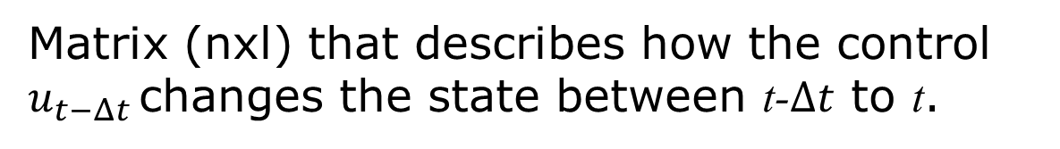
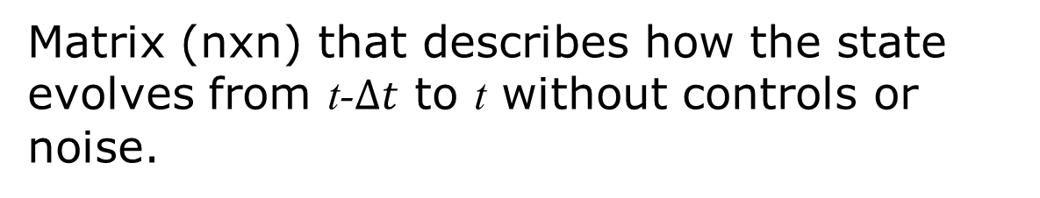
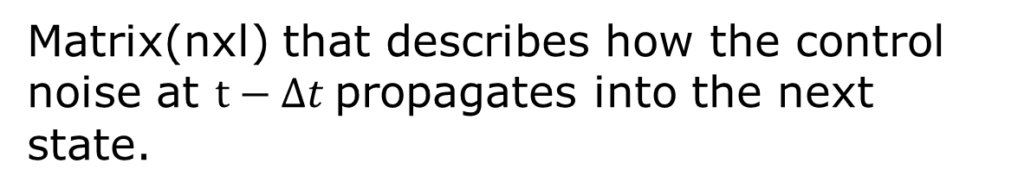
Matrices of a Kalman Filter
Matrix (nxn) that describes how the state evolves from t-$Δt$ to t without controls or noise.
Matrix (nxl) that describes how the control $u_{t−Δt }$changes the state between t-$Δt$ to t.
Matrix(nxl) that describes how the control noise at $t−Δt$propagates into the next state.
Matrix (kxn) that describes how to map the state x_{t} to an observation z_{t}.

Slide 7
Random Variables of a Kalman Filter
Random variables represent the control, process, and measurement noises. They are assumed to be zero-mean, white, independent of each other, and normally distributed.
Additive control noise with variance $U_{t−Δt}$
Additive process (or plant) noise with covariance matrix $R_{t−Δt}$
Additive measurement noise with covariance matrix $Q_{t}$

Slide 8

Why Change the KF Model
It allows us to more easily account for the effects of the control and its variations, “noises”, through the time from t-$∆t$to t.

Slide 9
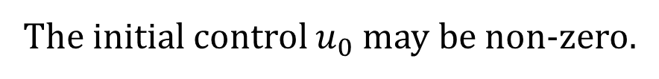

Kalman Filter Initialization
The initial belief is Gaussian
$$bel\left(x_{0}\right)=p\left(x_{0}\right)=𝒩\left(x_{0};{\hat{x}}_{0|0},P_{0|0}\right)$$
The initial control $u_{0}$ may be non-zero.
The initial control noise is Gaussian $ψ_{0}\sim 𝒩\left(ψ_{0};0,U_{0}\right)$
The initial plant noise is Gaussian $ε_{0}\sim 𝒩\left(ε_{0};0,R_{0}\right)$

Slide 10
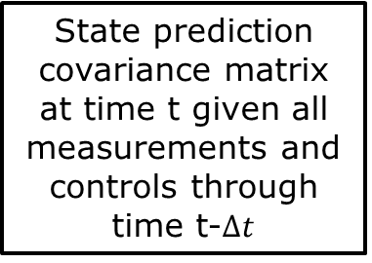

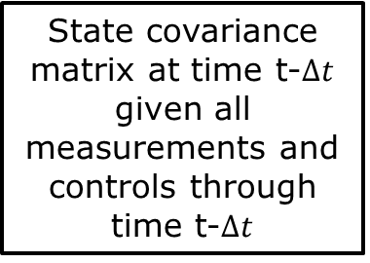
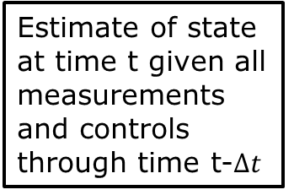
New Kalman Filter Prediction Equations
$${\hat{x}}_{t|t−Δt}=A_{t−Δt}{\hat{x}}_{t−Δt|t−Δt}+B_{t−Δt}u_{t−Δt}$$
Estimate of state at time t given all measurements and controls through time t-$∆t$
Estimate of state at time t-$∆$t given all measurement and controls through time t-$∆t$
$$P_{t|t−Δt}=A_{t−Δt}P_{t−Δt|t−Δt}{A_{t−Δt}}^{T}+D_{t−Δt}U_{t−Δt}{D_{t−Δt}}^{T}+R_{t−Δt}$$
State prediction covariance matrix at time t given all measurements and controls through time t-$∆t$
State covariance matrix at time t-$∆t$ given all measurements and controls through time t-$∆t$
Covariance matrix for plant noise
Covariance matrix due to control noise

Slide 11

Linear Gaussian Measurement Model
$$z_{t}=C_{t}x_{t}+δ_{t}$$
Vector of sensor measurements
Measurement noise vector
Measurement matrix that relates states to measurements
Measurement noise is assumed to be zero mean Gaussian with covariance matrix Q. It is assumed to be independent of control and plant noise.
The control, plant, and measurement noise vectors are assumed to be “white”, i.e., independent of noises at previous times.

Slide 12





Kalman Filter Update Equations
Innovation
$${\overline{y}}_{t}=z_{t}−C_{t}{\hat{x}}_{t|t−Δt}$$
Innovation Covariance
$$S_{t}=C_{t}P_{t|t−Δt}{C_{t}}^{T}+Q_{t}$$
Kalman Gain
$$K_{t}=P_{t|t−Δt}{C_{t}}^{T}{S_{t}}^{−1}$$
Updated Estimate
$${\hat{x}}_{t|t}={\hat{x}}_{t|t−Δt}+K_{t}{\overline{y}}_{t}$$
Update Covariance
$$P_{t|t}=\left[I−K_{t}C_{t}\right]P_{t|t−Δt}$$

Slide 13


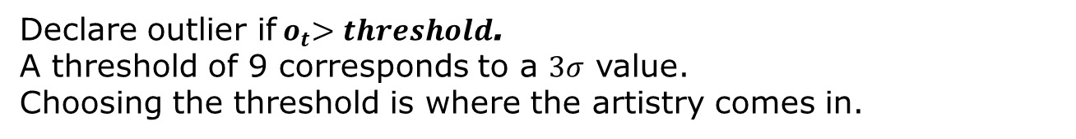

Check for Outliers
To check for outliers, test the innovation against its covariance.
Innovation:
$${\overline{y}}_{t}=z_{t}−C_{t}{\hat{x}}_{t|t−Δt}$$
Innovation Covariance:
$$S_{t}=C_{t}P_{t|t−Δt}{C_{t}}^{T}+Q_{t}$$
Outlier Check:
$$o_{t}={{\overline{y}}_{t}}^{T}S_{t}{\overline{y}}_{t}$$
Declare outlier if${ o}_{t}>threshold$.
A threshold of 9 corresponds to a $3σ$ value.
Choosing the threshold is where the artistry comes in.

Slide 14

Check for Divergence
To periodically check for divergence, examine the mean and covariance of the residual over a local window
Residual:
$${\overline{y}}_{t|t}=z_{t}−C_{t}{\hat{x}}_{t|t}$$
The mean of local residual should be “near” zero.
The covariance of the local residual should be “near” $C_{t}P_{t|t}{C_{t}}^{T}+Q_{t}$
The artistry involve choosing the size of the local window and
what “near” should be in both these tests.

Slide 15
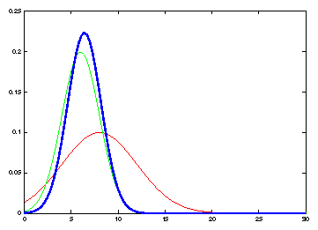
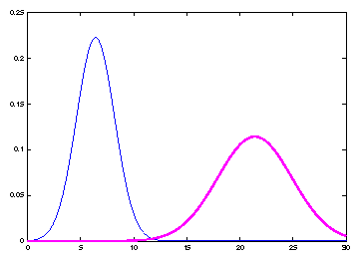
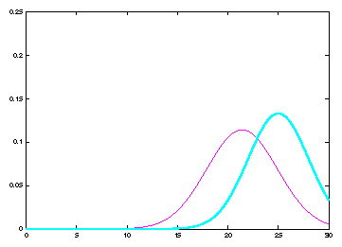
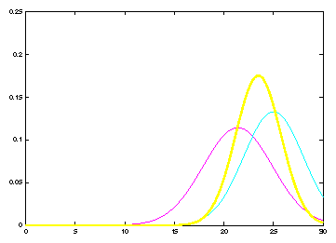
Kalman Filter Cycle
Previous Belief
Prediction
Measurement
Update

Slide 16
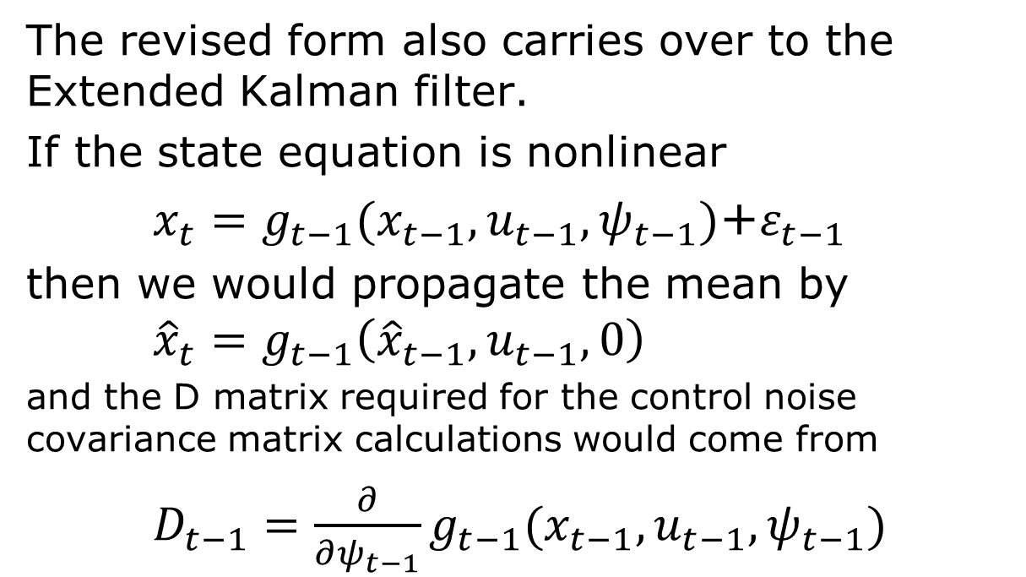
The Extended Kalman Filter
The revised form also carries over to the Extended Kalman filter.
If the state equation is nonlinear
$x_{t}=g_{t−1}(x_{t−1},u_{t−1},ψ_{t−1})$+$ε_{t−1}$
then we would propagate the mean by ${\hat{x}}_{t}=g_{t−1}\left({\hat{x}}_{t−1},u_{t−1},0\right)$
and the D matrix required for the control noise covariance matrix calculations would come from
$D_{t−1}=\frac{∂}{∂ψ_{t−1}}g_{t−1}(x_{t−1},u_{t−1},ψ_{t−1})$

Slide 17
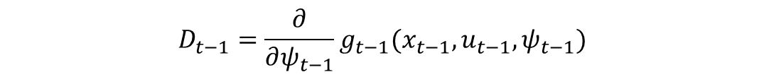
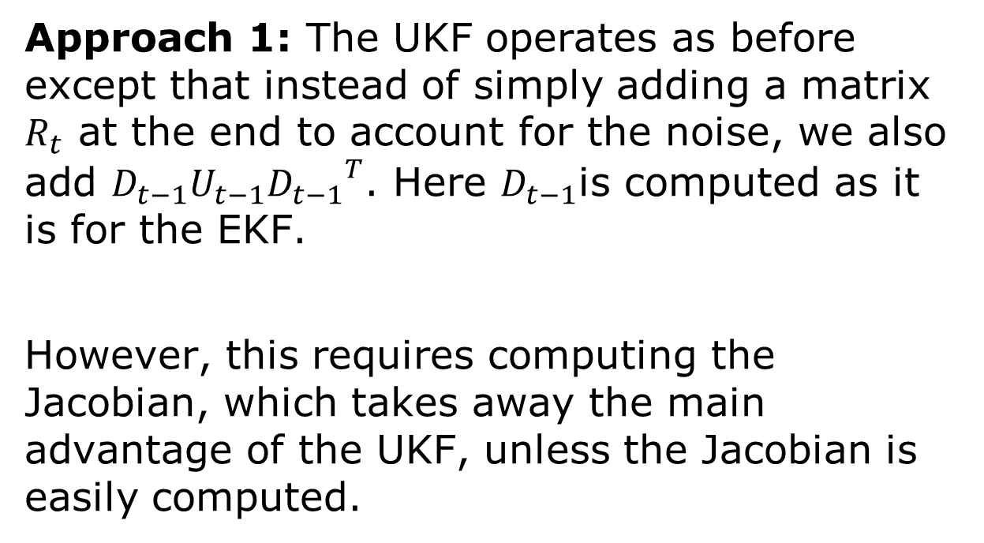
The Unscented Kalman Filter(1)
Approach 1: The UKF operates as before except that instead of simply adding a matrix $R_{t}$ at the end to account for the noise, we also add $D_{t−1}U_{t−1}{D_{t−1}}^{T}$. Here $D_{t−1}$is computed as it is for the EKF.
However, this requires computing the Jacobian, which takes away the main advantage of the UKF, unless the Jacobian is easily computed.
$$D_{t−1}=\frac{∂}{∂ψ_{t−1}}g_{t−1}(x_{t−1},u_{t−1},ψ_{t−1})$$

Slide 18
The Unscented Kalman Filter(2)
Approach 2: For robots, the process noise is often modelled as variations in the control variables. We can treat the controls like states and use the standard UKF machinery to account for the propagation of these variations through the nonlinear dynamics.
The disadvantage is that it adds more “states” and more “sigma points” which must be propagated through the nonlinearities.

Slide 19
The Particle Filter
To model variations in the control parameters, we can sample simultaneously from both the control parameter distribution as well as the state distribution.
These sample points are them propagated through the nonlinear dynamics.

Slide 20
Conclusions
The choice of filter form usually depends on the problem.
For mildly nonlinear dynamics, the choice between the EKF and the UKF will depend on how easily the Jacobian can be calculated versus how easy it is to calculate the nonlinearities.
The PF is usually the best choice when the dynamics are highly nonlinear and/or the distributions are very non-Gaussian.

Slide 21
General Observation
It is usually better to slightly overestimate the motion variation (process and control noises) and depend on the sensors to reduce the uncertainty.
That makes accurate sensor models more important.
The more measurements you can take, the better.

